Slide 1
Fixed Income analysis Lecture Final project
Tony Zhang
Fall 2019
© 2016 CFA Institute. All rights reserved.

Slide 2
Agenda
Final Projects (PD modeling)
Introduction
Data
Univariate and Multivariate Analysis
Model Creation
Model Performance Evaluation
Documentation and Presentation

Slide 3
Introduction
In credit risk, one major concern is who a bank should loan its money to.
When a client applies for a loan, the bank would like to be sure that the client will pay back the full amount of the loan.
We need effective models that allow us to predict if a client will pay back the loan (PD).
What we have is historical data for several variables (from Lending Club).
We are trying to develop a model to this historical data so we can estimate a probability of default.

Slide 4
Data
Our data is provided by Lending Club and include details of completed loan agreements
The variables included are:
Loan Amount
Income
Location
dti
Maturity
Default

Slide 5
Data
Sample Selection
We split the sample into two parts
The modelling sample (first 90%)
This new sample is used to create the model.
The validation sample (last 10%)
The remaining data is used to validate the model
We test how many defaults the model predicted and which of them really did default.

Slide 6
Univariate and Multivariate analysis
We have a dependent variable, which is default, and some independent variables (Loan Amount, income,…)
First of all, we do univariate analysis.
For each variable, we calculate some statistics like mean, standard deviation, skewness…
We plot some histograms…
This information can be use as a first check before applying the model.
It would be better if the data were homogeneous.

Slide 7
Univariate Analysis
Frequency Distribution Tables
Bar Charts
Histograms
Frequency Polygons
Pie Charts
Text Mining (WordClouds)

Slide 8
Bivariate analysis
Scatter Plot
Regression analysis

Slide 9
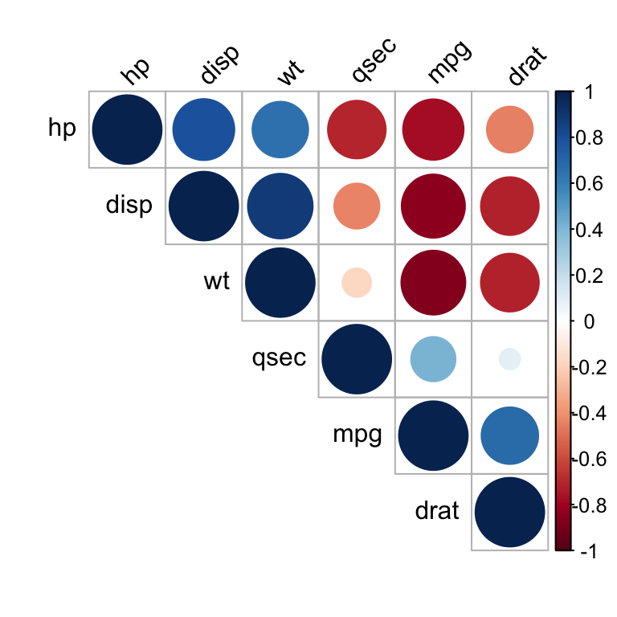
Multivariate analysis
Correlations

Slide 10
Model Creation
According to the results of the Univariate and Multivariate Analysis, select the list of candidate variables to be included in our model
Make sure the variables selected make business sense
Variables will be further selected based on statistical significance.

Slide 11
Model creation
Linear regression
Logistic regression
Survival analysis (Cox model)
Machine learning (Decision tree, Neural network, SVM, etc.)

Slide 12
Variable selection
Obtain initial list of candidate variables from univariate and multivariate analysis, fit into the model to see:
p-value
VIF test
Further refine the variable lists (optional)
Step-wise regression
Principal Component Analysis (PCA)
Lasso

Slide 13
Model specification
List of final variables and coefficients
For example
Intercept -1.85136
Age -0.02678
Income 0.10025
Wealth -0.01761
Marital Status 0.79651
Maturity 0.00892

Slide 14
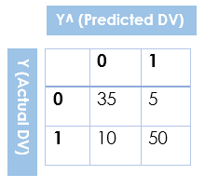
Model performance evaluation
Confusion Matrix
False Positive (FP)
instances that are incorrectly classified as Positive Class instances (0,1)
False Negative (FN)
instances that are incorrectly classified as Negative Class instances (1,0)
True Positive (TP)
instances that are correctly classified as Positive Class instances (1,1)
True Negative (TN)
instances that are correctly classified as Negative Class instances (0,0)
Accuracy rate = Correct/ total = (50+35)/ 100 = 85%

Slide 15
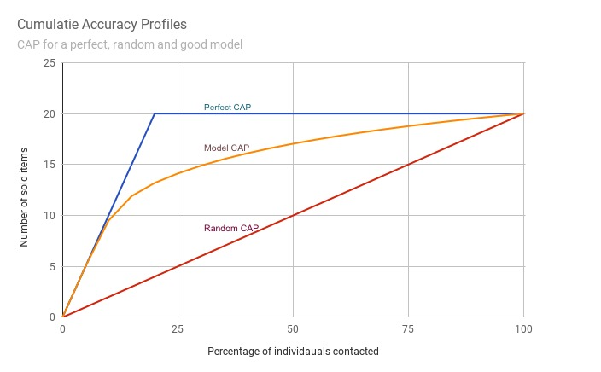
Model performance evaluation
Cumulative Accuracy Profile (CAP) Curve
$$Accuracy ratio \left(AR\right)=\frac{Area under Model CAP−Area under Random CAP}{Area under Perfect CAP −Area under Random CAP}$$

Slide 16
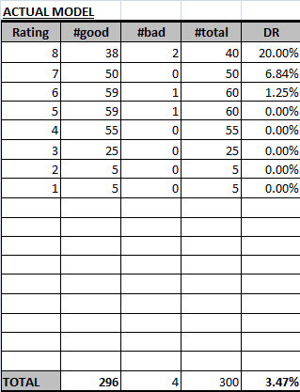
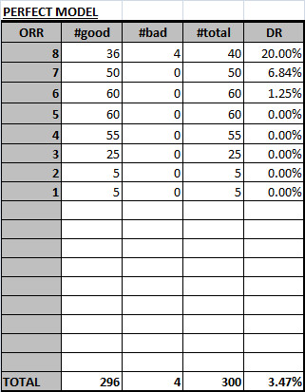
Model performance evaluation
CAP calculation
Sort the borrower rating pool (in our case, predicted PD for each borrower) from worst to best grade.
Find the cumulative number of borrowers (x) and also cumulative number of defaults (y) against each grade. For eg, x for rating grade 8 would be 40/300 = 13.3% and y for rating grade 8 would be 2 / 4 = 50%. Similarly x for rating grade 7 would be (50 + 40)/300 = 30% and y would be (2+0)/4 = 50%, and so on.
Find the area under the curve

Slide 17
Model Performance Evaluation
In Sample test
Confusion Matrix
CAP and accuracy ratio
Out-of-sample test
Confusion Matrix
CAP and accuracy ratio

Slide 18
Model Documentation
Introduction
Data
Univariate and Multivariate Analysis
Model Creation
Model Performance Evaluation
Final Model Selection
Model Limitation
Conclusion

Slide 19
Presentation
Form a team with 3-4 people
Team work collaboration
Present the model in class (12/5) for 10-15 mins
Submit the model doc and slides (12/11)

Slide 20
Optional Step
Missing Data
Remove
Mean Imputation
Expectation Maximization (EM) Imputation
It is an iterative procedure in which it uses other variables to impute a value (Expectation), then checks whether that is the value most likely (Maximization). If not, it re-imputes a more likely value. This goes on until it reaches the most likely value.
EM imputations are better than mean imputations because they preserve the relationship with other variables, which is vital if you go on to use something like Factor Analysis or Linear Regression.

Slide 21
Optional Step
Data Relevance
When use external dataset to develop a model
e.g. Use Moody’s data to develop PD model for HSBC
Population Stability Index (PSI)
Compare the distribution of a scoring variable (predicted probability) in scoring data set to a training data set that was used to develop the model. The idea is to check "How the current scoring is compared to the predicted probability from training data set".

Slide 22
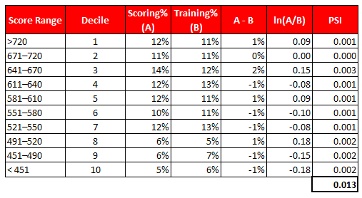
PSI example
PSI = (% of records based on scoring variable in Scoring Sample (A) - % of records based on scoring variable in Training Sample (B)) * In(A/ B)
Sort scoring variable on descending order in scoring sample
Split the data into 10 or 20 groups
Calculate % of records in each group based on scoring sample
Calculate % of records in each group based on training sample
Calculate difference between Step 3 and Step 4
Take Natural Log of (Step3 / Step4)
Multiply Step5 and Step6
Rules:
PSI < 0.1 – No difference
PSI >=0.1 but <= 0.2 – Slight difference
PSI >=0.2 – Significant difference

